Slide 1




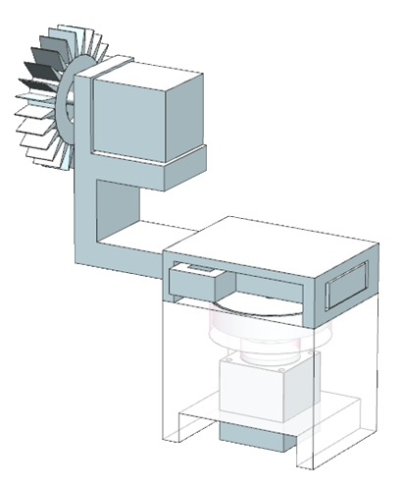
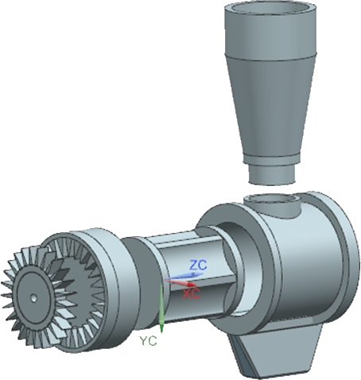
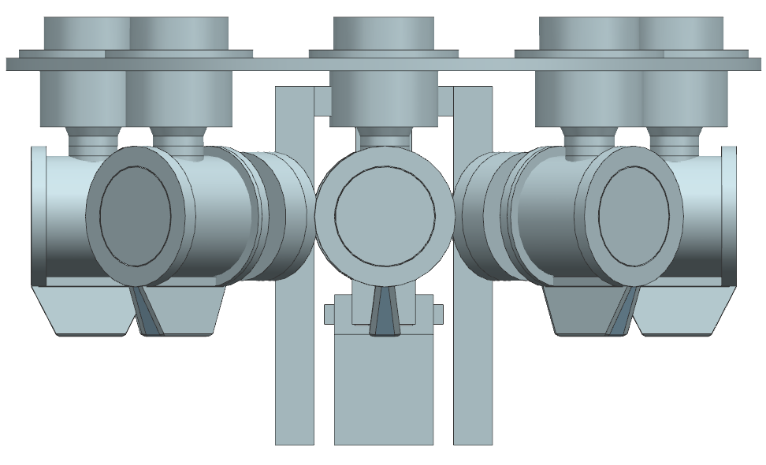
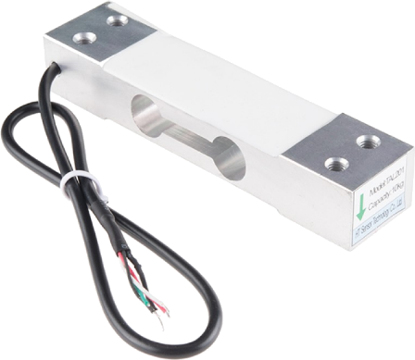
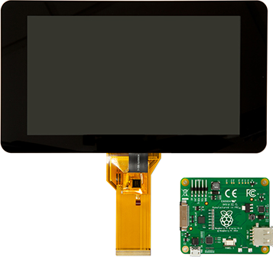
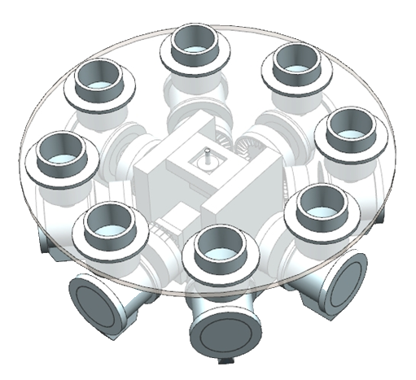
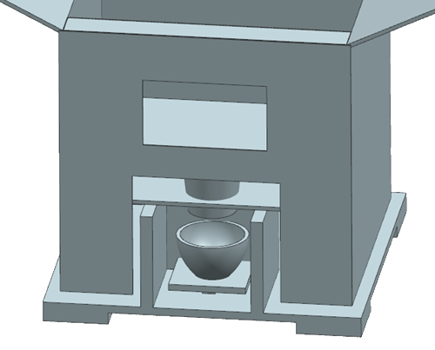
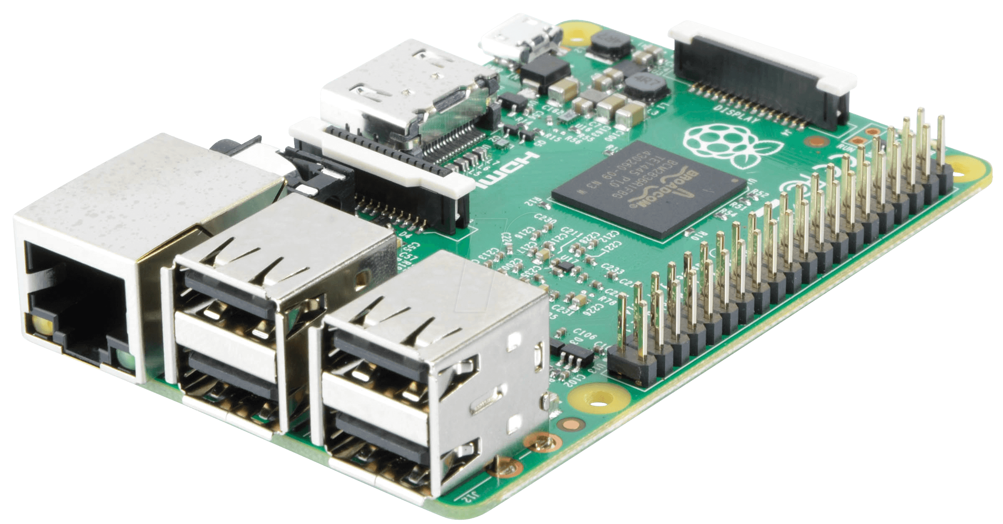
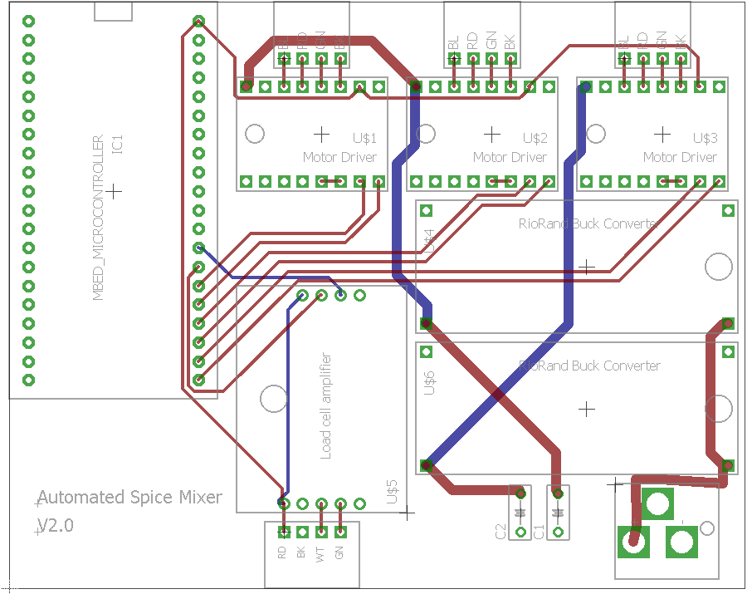














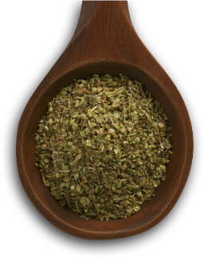
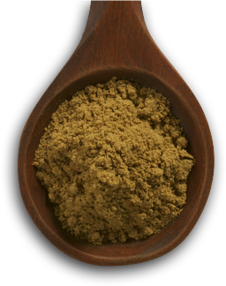
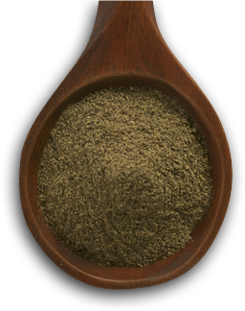
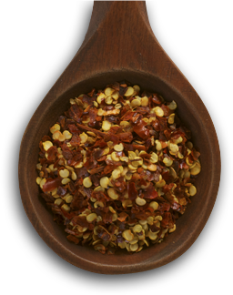
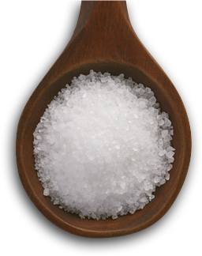
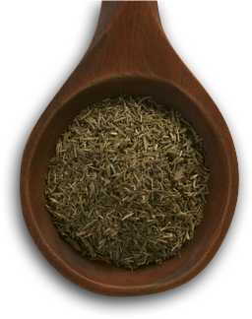
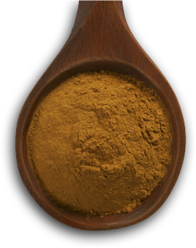
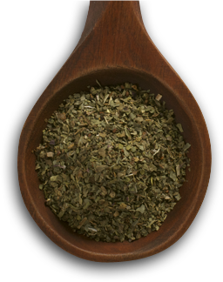
What Does It Do?
The automated spice mixer is capable of storing up to eight spices with various textures (crystals, powders, flakes) and dispense each spice with high precision.
Supported Spice Types
Mechanical Functions
CRYSTAL
FLAKES
POWDER
ECE Functions
Storing
Dispensing
Weighing
Internet of
Things
User
Interface
Distributed
Computing
Mechanical Mechanisms
Design Highlights
Hold up to eight containers
Rotates spice hoppers to dispensing position
ECE Mechanisms
Scotch Yoke
Rotary Valve
CONTAINERS
CAROUSEL
Load Cell
LCD Touchscreen
Dispensing Gear
Rotary Valve
Fixed
Convert mechanical force into electrical output signal using load cell to determine weight
Ability to create a standalone device with an all-in-one interactive interface
Motors
Hopper
Applied Load
Scotch Yoke
Casing
Scotch Yoke Base
Gear Ring
Specifically designed for spice textures
Air tight rotary valves dispense spice
Capacity: 780 g
Size 7 Inches
Gear
OPENINGS
VALVES
Resolution 0.1 g
RES 800 x 480
Carousel
Dispensing
Used to connect to dispensing gear
Raspberry Pi 3
PCB Board
Rotating Disk
Ensure constant spice flow
DISPENSE
SCOTCH YOKE
Provides the circuit backbone for components and custom connectors to facilitate motor and load cell connection
Motor
Full-fledged processor to support networking stack, GUI, and control of devices.
Motor Base
Features
1.2 GHz Quad Core ARM
Dispensing Mechanism
Display Interface
Spice Catcher
Load Cell
8 Components
Custom Made
3D Printed
Materials
Hardware
Motors/Power
Hardware
Devices
Auto Dispensing
Predefined recipes conveniently dispensed
Cloud Integration
Real time synchronization with database
Unit Conversion
Seamlessly convert between volume and mass
Precision
Accurate to tenth of a gram up to 780 grams
$12.00
$17.50
$30.50
Industry Applications
$78.00
$22.00
$100.00
Rotary Valve
Wood Frame
Bearings
Culinary
Dispense and mix spices on a commercial scale
Pharmaceutical
Automate patient’s daily dosage of medicine
Agricultural
Dispense pesticide and fertilizer mixes on a large scale
Manufacturing
Seamlessly mix various powder mixtures
Stepper Motor
Printed Circuit Board
Raspberry Pi 3
Scotch Yoke
Hopper Mounting Disk
Fittings
Motor Shield
Load Cell
MBED
Motor Stand
Epoxy Glass
Hinges
Buck Converter
Load Cell Amplifier
7” LCD Touchscreen
Gears
Brackets
Power Supply
Mechanical
Components
$60
$260
Motors and Electronic Components
$200
Future Work
Oregano
Cumin
Pepper
Red Pepper Flakes
Salt
Thyme
Cinnamon
Basil
Future Work
1
Capability to change container sizes
3
Ability to clean the rotary valves
1
Data mining from online recipes
3
Push notifications to mobile application
2
Different design model for commercial application
4
Capability to change the number of containers
2
Computer vision to improve dispensing precision
4
Full control via web application
This poster is designed by Ratchapong Tangkijvorakul and Sunny Patel

